Slide 1

SMART INDIA HACKATHON 2026
TITLE PAGE
Problem Statement ID – SIH26183
Problem Statement - Real-Time Identification of Fraud-Linked Cryptocurrency Exchanges from Victim-Reported Suspect Wallet Addresses through Automated Blockchain Analytics.
Theme- Blockchain & Cybersecurity
PS Category- Software
Team ID-
Team Name - CYPHERX

Slide 2

IDEA TITLE
CYPHERX
Proposed Solution
CryptoTrace is a blockchain analytics tool that traces stolen cryptocurrency from a reported wallet or transaction hash through its subsequent on-chain movements. It builds a transaction graph, tracks split fund flows, identifies known exchange/VASP endpoints, and generates an auditable investigation report.
Victim reports Suspect Wallet Address
1 INCIDENT INPUT
Wallet / TX hash
2 TRACE ENGINE
Transactions + graph
3 FUND ANALYSIS
DFS/BFS + accounting
4 REPORT
Paths + endpoints
_{Blockchain Data Collection}
_{Transaction & Entry Analysis}
How it addresses the problem
Reduce dependence on manual blockchain tracing.
Turns a suspects wallet address into an actionable investigations.
Supports faster fund-flow tracing and evidence .
Help investigators prioritize exchanges /vasp leads for follow-up.
Wallet balances mix pre-existing funds with stolen crypto, misleading total loss calculations.
Manual searches take hours, allowing thieves to off-ramp funds at exchanges before detection.
_{Fraud Detection.}
Identify Fraud Linked Exchanges

Slide 3


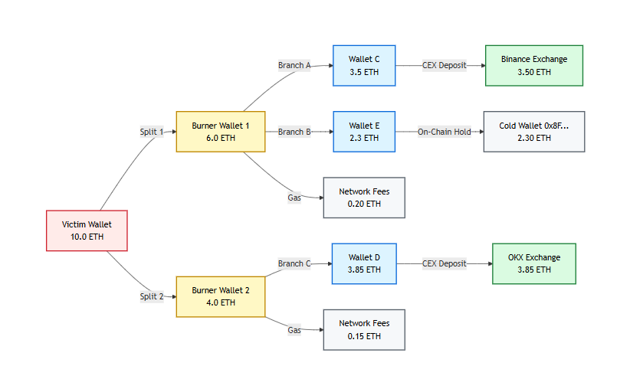
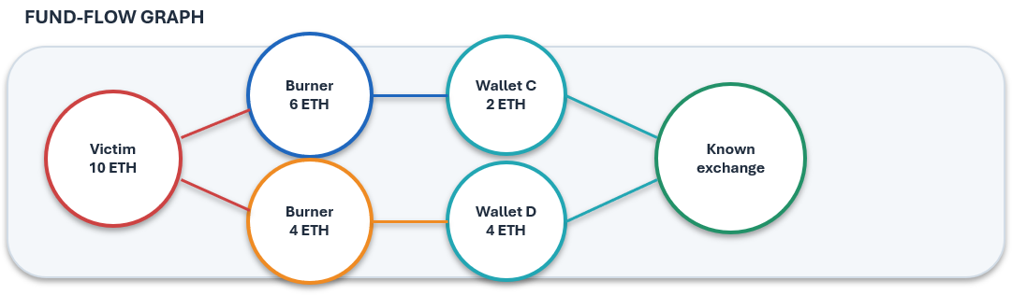
TECHNICAL APPROACH
From one incident to an auditable fund-flow graph
Technology stack
Core data model
Algorithms
Attribution
Python
Web3 / RPC / API
JSON /CLI
• Node = wallet / address / contract
• Edge = transaction + asset + amount
• Metadata = hash • time • block
• DFS / BFS / recursion
• Cycle handling + depth limits
• Fund propagation + reconciliation
• Known-service labels
• Evidence + confidence
• No invented real-world identity
END-TO-END IMPLEMENTATION FLOW
1
Incident
input
2
RPC / API
fetch
3
TX parser
4
Graph
builder
5
DFS / BFS
trace
6
Accounting
7
Endpoint +
report
INVESTIGATIVE OUTPUT
TRACE SUMMARY
• 10.00 ETH initial
• 8.70 ETH tracked
• 1.30 ETH unaccounted
• Endpoint: KNOWN SERVICE / UNKNOWN

Slide 4
FEASIBILITY AND VIABILITY
CYPHERX
Why this is feasible
Data availability
Software feasibility
Modular growth
1. Public blockchain history exposes transaction movement needed for tracing.
Python + Web3/RPC access + graph traversal are enough for a working MVP.
1. Start with ETH wallet transfers; add tokens, contracts, attribution and cross-chain later.
2. Transaction history can be programmatically queried
CHALLENGE → MITIGATION
API / rate limits
Caching, retries, bounded queries
Fund splits + cycles
Visited set + maximum depth
Gas / unrelated funds
Separate stolen-flow accounting
Contracts / DEX complexity
Keep V1 wallet-to-wallet ETH
Attribution uncertainty
Service label + confidence + evidence
Cross-chain movement
Mark unsupported/unaccounted; add later

Slide 5
IMPACT AND BENEFITS
CYPHERX
TARGET USERS
Victims
Investigators / officials
Developers / students
Understand where stolen funds moved and how much remains traceable.
Receive an auditable fund-flow summary for further investigation.
Learn blockchain analytics through a transparent graph-based tool.
BENEFITS
SOCIAL
ECONOMIC
Increase public trust in digital payments and crypto currency.
Helps protect victims of cryptocurrency
Reduces financial losses caused by crypto-related fraud.
Saves investigation time and manpower through automation.
Law-Enforcement impact:
TECHNICAL
Helps identify intermediary wallets and probable exchange/VASP endpoints.
Supports coordination and analytics in india’s cybercrime system
Creates foundation for automated crypto-forensics and future innovation.
Combines blockchain + Graph Analytics

Slide 6
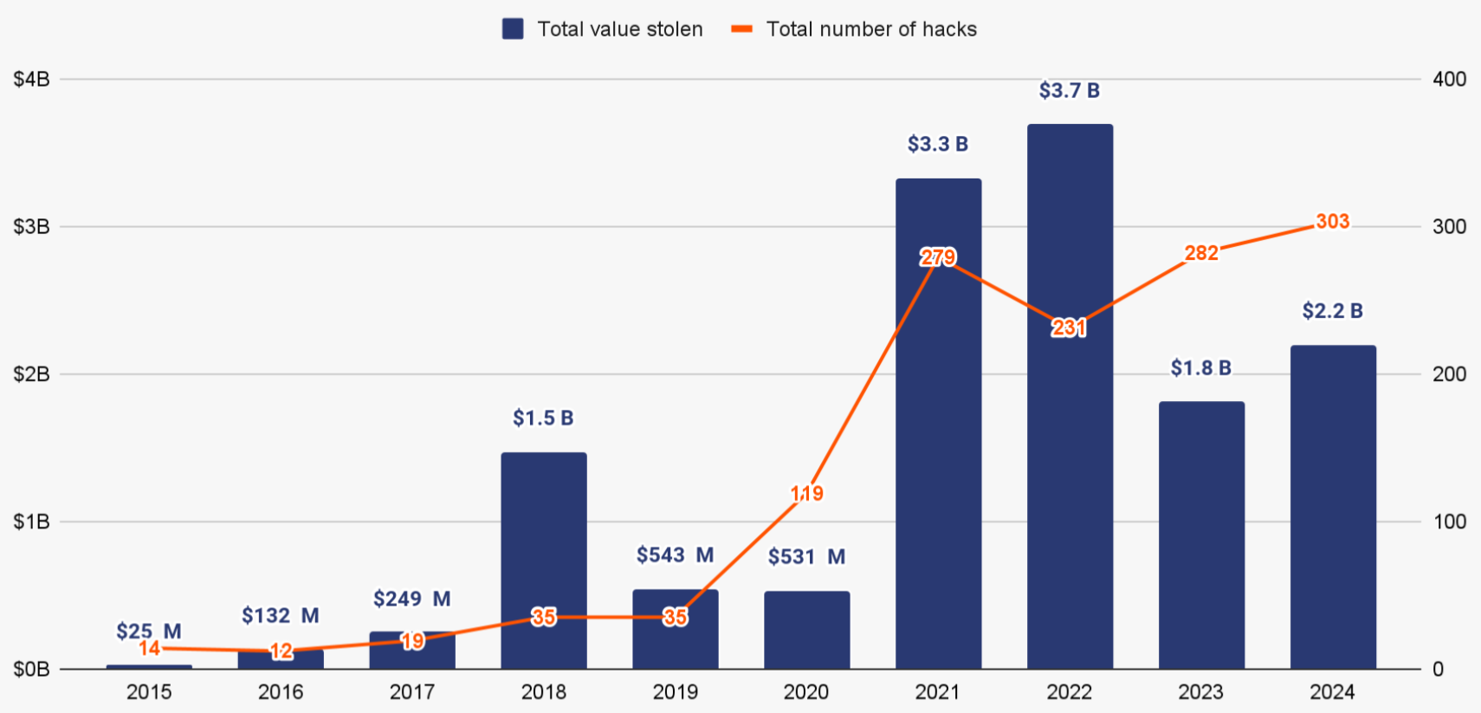
RESEARCH AND REFERENCES
CYPHERX
REFERENCES
https://ethereum.org/whitepapeR
https://www.chainalysis.com
https://www.fbi.gov
https://www.fbi.gov/news/press-releases/-fraud-report
https://www.youtube.com/watch
https://arthbit.com/
TRMLAB DOCUMENTATION

